Slide 1
Software Testing
The process or practice of investigating a software / system under test so as to ensure that it is of the highest quality.
OR
Software Testing is evaluation of the software against requirements gathered from users and system specifications
OR
Software testing is the act of examining the artifacts and techniques, design patterns executing a program or application with the intent of exam the behaviour of the software under test by validation and verification.
Software testing techniques includes
1) Analyzing the product requirements for completeness and correctness.
2) Working with product developers on improvement in coding behavior.
4) Reviewing the deployment infrastructure and associated scripts and automation.
5) Reviewing the product architecture and the overall design of the product

Slide 2
Software Testing
-STLC stands for Software Testing Life Cycle.
-STLC is a sequence of different activities performed by the testing team to ensure the quality of the software or the product.
STLC provides a step-by-step process to ensure quality software.
STLC Phases
-STLC has the following different phases but it is not mandatory to follow all phases.
Phases are dependent on the nature of the software or the product, time and resources allocated for the testing and the model of SDLC that is to be followed.

Slide 3
Software Testing
-Software Testing Principles:
All tests should be traceable to customer requirements.
Tests should be planned long before testing begins.
The Pareto principle applies to software testing.
Testing should begin “in the small” and progress toward testing “in the large”.
Exhaustive testing is not possible
To be most effective, testing should be conducted by an independent third party.

Slide 4
Software Testing
-Testability
Software testability is simply how easily [a computer program] can be tested.
1) Operability 2) Observability 3) Controllability
4) Decomposability 5) Simplicity 6) Stability
7) Understandability
There are seven principles in software testing: 1) Testing shows the presence of defects 2)Exhaustive testing is not possible 3) Early testing 4)Defect clustering 5) Pesticide paradox 6) Testing is context-dependent 7) Absence of errors fallacy

Slide 5
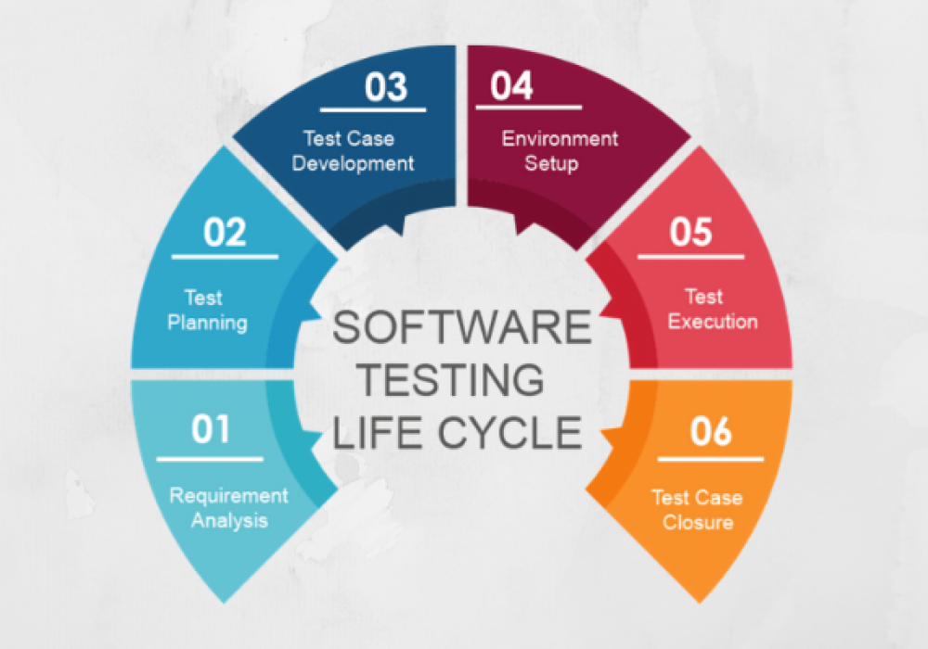
Software Testing
- STLC Phases

Slide 6
Software Testing
STLC Phases
1) Requirement Analysis Phase
Tester analyses requirement document of SDLC (Software Development Life Cycle) to examine stated by the client.
This phase examines functional and non-functional requirements from the testing perspective to identify the testable needs.
The entry criteria for this phase is the BRS (Business Requirement Specification) document.
During this phase, the test team studies and analyzes the requirements from a testing perspective.
This phase helps to identify whether the requirements are testable or not.

Slide 7
Software Testing
STLC Phases
1)Requirement Analysis Phase
This phase helps to identify whether the requirements are testable or not.
If any requirement is not testable, the test team can communicate with various stakeholders (Client, Business Analyst, Technical Leads, System Architects, etc) during this phase so that the mitigation strategy can be planned.

Slide 8
Software Testing
STLC Phases
2) Test Planning:
-Test planning is the first step in the testing process.
-In this phase typically Test Manager/Test Lead involves determining the effort and cost estimates for the entire project.
- Test plan creation is the crucial phase of STLC where all the testing strategies are defined.
-Activities like resource planning, determining roles and responsibilities, tool selection (if automation), training requirements, etc., carried out in this phase.
- Testing strategy and effort estimation documents provided by this phase

Slide 9
Software Testing
STLC Phases
3) Test Case Development:
Develop the test cases based on scope and criteria’s.
The test team starts with test case development activity here in this phase. Testers prepares test cases, test scripts (if automation), and test data.
Once the test cases are ready then these test cases are reviewed by peer members or team lead.

Slide 10
Software Testing
STLC Phases
4) Test Environment Setup:
-Environment setup requires a group of essential software and hardware to create a test environment.
-This phase can be started in parallel with the Test design phase.
. The test team is required to do a readiness check (smoke testing) of the given environment.
In some cases, the test team may not be involved in this phase.
The development team or customer provides the test environment.

Slide 11
Software Testing
STLC Phases
5) Test Execution:
Testing of the software build is done based on test plans and test cases prepared.
The process consists of test script execution, test script maintenance and bug reporting.
Document test results, and log defects for failed cases.
If bugs are reported then it is reverted back to development team for correction and retesting will be performed.
RTM (Requirement Traceability Matrix) is also prepared in this phase.
In RTM each test case is mapped with the requirement specification.
If a test case result is Pass/Fail then the same should be updated in the test cases.

Slide 12
Software Testing
STLC Phases
5) Test Execution:
The defect report should be prepared for failed test cases and should be reported to the Development Team.
Mapping of test cases according to requirements.

Slide 13
Software Testing
STLC Phases
6) Test Case closure:
Test Cycle Closure phase is completion of test execution which involves several activities.
The testing team will be called out for a meeting to evaluate cycle completion criteria based on Test coverage, Quality, Time, Cost, Software, Business objectives.
The test team analyses the test artifacts (such as Test cases, Defect reports, etc.,) to identify strategies that have to be implemented in the future, which will help to remove process bottlenecks in the upcoming projects.
Qualitative and quantitative reporting of quality of the work product to the customer.

Slide 14
Software Testing
STLC Phases
6) Test Case closure:
Test Cycle Closure phase is completion of test execution which involves several activities.
The testing team will be called out for a meeting to evaluate cycle completion criteria based on Test coverage, Quality, Time, Cost, Software, Business objectives.
The test team analyses the test artifacts (such as Test cases, Defect reports, etc.,) to identify strategies that have to be implemented in the future, which will help to remove process bottlenecks in the upcoming projects.
Qualitative and quantitative reporting of quality of the work product to the customer.

Slide 15
Software Testing
Quality: -Quality is meeting the requirement, expectation, and needs of the customer is free from the defects, lacks and substantial variants.
- There are standards needs to follow to satisfy the customer requirements.
-Quality of design refers to the characteristics that designers specify for an item.
The grade of materials, tolerances, and performance speciﬁcations all contribute to the quality of design.
Quality of conformance is the degree to which the design specifications are followed during manufacturing.
Again, the greater the degree of conformance, the higher is the level of quality of conformance.
Quality of design and quality of conformance
User satisfaction = Compliant product + Good quality +
Delivery within budget and schedule

Slide 16
Software Testing
Quality:
-The modern read of high-quality associates with software -many quality factors like the following:
1)Portability 2) Usability
3) Reusability 4) Correctness
5) Maintainability
Quality control
-Involves the series of inspections, reviews, and tests used -throughout the software process to ensure each work product meets the requirements of users.
-Quality control includes a feedback loop to the process that created the work product.
- Quality control as part of the manufacturing process.

Slide 17
Software Testing
Quality Control:
A key concept of quality control is that all work products have deﬁned, measurable speciﬁcations to which we may compare the output of each process.
Quality Assurance
Is defined as a procedure to ensure the quality of software products or services provided to the customers by an organization.
Quality assurance focuses on improving the software development process and making it efficient and effective as per the quality standards defined for software products.
Quality assurance consists of the auditing and reporting functions of management.
Quality assurance consists of the auditing and reporting functions of management.

Slide 18
Software Testing
Difference of Quality Control & Assurance:
Quality Control | Assurance
It focuses on providing assurance that the quality requested will be achieved. | It focuses on fulfilling the quality requested
It is the technique of managing quality. | It is the technique to verify quality.
It is involved during the development phase. | It is not included during the development phase.
t does not include the execution of the program. | It always includes the execution of the program.
It is a managerial tool. Ex: Verification | It is a corrective tool. Ex: Validation

Slide 19
Software Testing
Software Quality Assurance Activity:
-Software Quality Assurance (SQA) is simply a way to assure quality in the software.
- It is the set of activities which ensure processes, procedures as well as standards are suitable for the project and implemented correctly.
-SQA is kind of Umbrella activity that is applied throughout the software process.
Prepares an SQA plan for a project
Participates in the development of the project's software process description
Reviews software engineering activities to verify compliance with the defined software process.
Audits designated software work products to verify compliance with those defined as a part of the software process.

Slide 20
Software Testing
Software Quality Assurance Activity:
5)SQA is kind of Umbrella activity that is applied throughout the software process.
6) Ensures that deviations in software work and work products are documented and handled according to a documented procedure
7) Records any noncompliance and reports to senior management.

Slide 21
Software Testing
Verification and Validation :
-Verification and Validation is the process of investigating that a software system satisfies specifications and standards and it fulfills the required purpose
Verification:
It is the process to ensure whether the product that is developed is right or not. It verifies whether the developed product fulfills the requirements that we have. Verification is static testing. Verification means Are we building the product right?
Validation:
It is the process of checking the validation of product i.e. it checks what we are developing is the right product. it is validation of actual and expected product. Validation is the dynamic testing. Validation means Are we building the right product?

Slide 22
Software Testing
Verification:
-Veriﬁcation refers to the set of activities that ensure that software correctly implements a speciﬁc function.
Verification means Are we building the product right?
Validation
-Validation refers to a different set of activities that ensure that the software that has been built is traceable to customer requirements.
Validation means Are we building the right product?

Slide 23
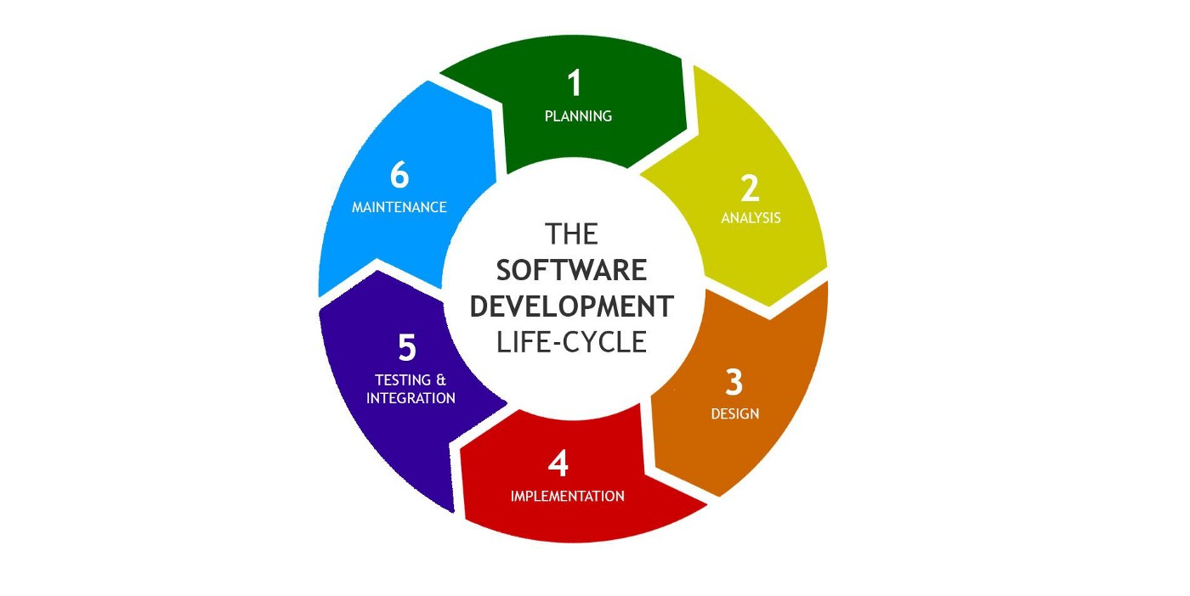
Software Testing
SDLC Model:

Slide 24
Software Testing
White box testing
-White box testing techniques analyze and test the internal structures
-WBT used data structures, internal design, code structure and the working of the software rather than just the functionality .
-It is also called glass box testing or clear box testing or structural testing.
- In WBT coding are tested to verify input-output flow and improve design, usability, and security.
-In white box testing, code is visible to testers, so it is also called Clear box testing, Open box testing, Transparent box testing, Code-based testing, and Glass box testing.

Slide 25
Software Testing
White box testing
-Following are important WhiteBox Testing Techniques: 1)Statement Coverage 2)Decision Coverage 3)Branch Coverage 4)Condition Coverage 5)Multiple Condition Coverage 6)Finite State Machine Coverage 7)Path Coverage 8)Control flow testing 9)Data flow testing

Slide 26
Software Testing
Black box testing :
-Black box testing is a type of software testing in which the functionality of the software is not known.
The testing is done without the internal knowledge of the products and implementation details and internal paths.
The primary source of black box testing is a specification of requirements that is stated by the customer.
In this method, tester selects a function and gives input value to examine its functionality, and checks whether the function is giving expected output or not.

Slide 27
Software Testing
Black box testing :
Black Box Testing mainly focuses on input and output of software applications and it is entirely based on software requirements and specifications. It is also known as Behavioral Testing.

Slide 28
Software Testing
Static & Dynamic Testing :
-Static Testing is a type of a Software Testing method which is performed to check the defects in software without actually executing the code of the software application.
Static testing is done to avoid errors at an early stage of development as it is easier to identify the errors and solve the errors.
Dynamic testing is testing performed when code ior software is in running state.
To perform dynamic testing the software should be compiled and run.
Dynamic Testing is a type of Software Testing which is performed to analyze the dynamic behavior of the code.

Slide 29
Software Testing
Static Testing Techniques: - It includes the testing of the software for the input values and output values that are analyzed. Dynamic Testing is basically performed to describe the dynamic behavior of code

Slide 30
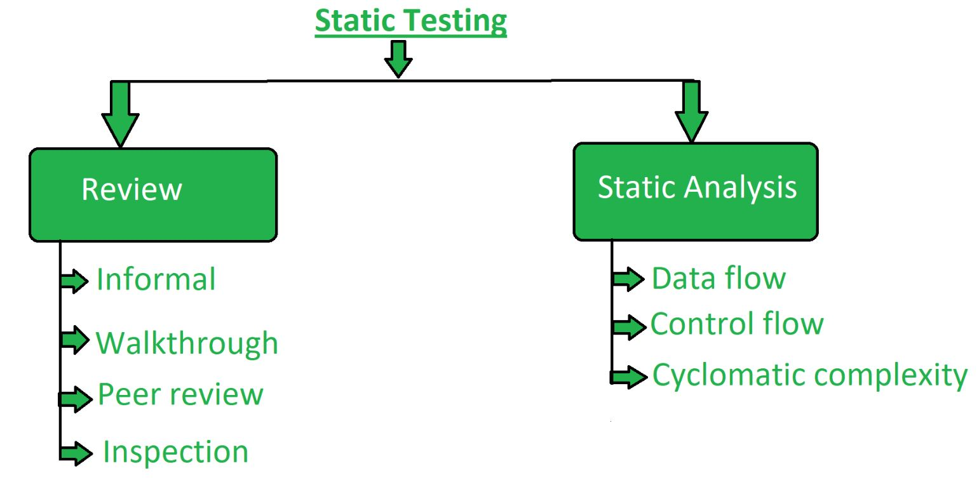
Software Testing
Static Testing Techniques: There are mainly two type techniques used in Static Testing:

Slide 31
Software Testing
Static Testing Techniques: There are mainly two type techniques used in Static Testing:
1. Review: -In static testing review is a process or technique that is performed to find the potential defects in the design of the software.
-It is process to detect and remove errors and defects in the different supporting documents like software requirements specifications.
-People examine the documents and sort out errors, redundancies and ambiguities.

Slide 32
Software Testing
Static Testing Techniques: There are mainly two type techniques used in Static Testing:
Review is of four types:
Informal: In informal review the creator of the documents put the contents in front of audience and everyone gives their opinion and thus defects are identified in the early stage.
Walkthrough: It is basically performed by experienced person or expert to check the defects so that there might not be problem further in the development or testing phase.
Peer review: Peer review means checking documents of one-another to detect and fix the defects. It is basically done in a team of colleagues.

Slide 33
Software Testing
Static Testing Techniques: There are mainly two type techniques used in Static Testing:
Inspection: Inspection is basically the verification of document the higher authority like the verification of software requirement specifications (SRS).

Slide 34
Software Testing
Static Testing Techniques: Static Analysis: Static Analysis includes the evaluation of the code quality that is written by developers. Different tools are used to do the analysis of the code and comparison of the same with the standard. It also helps in following identification of following defects:
Unused variables
Dead code
Infinite loops
Variable with undefined value
Wrong syntax

Slide 35
Software Testing
Static Testing Techniques: Static Analysis: Static Analysis is of three types:
1) Data Flow: Data flow is related to the stream processing.
2) Control Flow: Control flow is basically how the statements or instructions are executed.
3) Cyclomatic Complexity: Cyclomatic complexity is the measurement of the complexity of the program that is basically related to the number of independent paths in the control flow graph of the program

Slide 36
Software Testing
Structural Testing :
-Structural testing is to test the internal design of the software or structure of the coding for the particular software.
-In this testing, the development team members are included in the testing team to execute the software's internal design.
-The structural testing process requires an in-depth knowledge of the programming language and is opposite to Functional Testing.
-Throughout the structural testing, the test engineer intends on how the software performs, and it can be used at all levels of testing.

Slide 37
Software Testing
Structural Testing :
-Types of Structural Testing
Structural testing is divided into four different categories, which are as follows:
1) Mutation testing
2) Data flow testing
3) Control flow testing
4) Slice-based testing

Slide 38
Software Testing
Structural Testing :
1) Mutation testing
-It is used to check the quality of the test case that should fail the mutant code.
-It used to cause an error in the program, which implies that the mutation testing is performed to evaluate the test case's productivity.
2) Data flow testing
-It is a group of testing approaches used to observe the control flow of programs to discover the sequence of variables as per the series of events.
-It implements a control flow graph and analysis the points where the codes can change the data.

Slide 39
Software Testing
Structural Testing :
3) Control flow testing
-It is to check the implementation order of commands or statements of the code over a control structure.
-In the control flow testing, a specific part of an extensive program is selected by the test engineer to set the testing path.
-This entire test is based on how the control is executed during the code.
4)Slice-based testing
-The basic idea is to sort the complete code into small chunks and then evaluate each portion carefully.

Slide 40
Software Testing
Challenges In White Box Testing :
Lack of Understanding Of Programming Language(S) Used For Testing.
2) Lack Of Understanding The Logical Flow/Use Case .
3) Lack Of Patience To Go Thorough The Program.
4) Copying The Existing Functionality.
5) Not Being Honest Enough With The Client.

Slide 41
Software Testing
Black-box testing:
Black-box testing attempts to ﬁnd errors in the following categories:
incorrect or missing functions, (2) interface errors,
(3) errors in data structures or external data base access,
(4) behavior or performance errors,
and (5) initialization and termination errors.
Black-box testing Types:.
1) Functional testing –the functional requirements of a system; it is done by software testers.
2) Non-functional testing –Related to such as performance, scalability, usability.
3)Regression testing –is done after code fixes, upgrades or any other system maintenance to check the new code has not affected the existing code.

Slide 42
Software Testing
Black-box testing strategies:
1) Graph-Based Testing Methods 2) Equivalence Partitioning
3) Boundary Value Analysis 4)Orthogonal Testing:
5) Comparison Testing
1)Graph-Based Testing Methods
-Each and every application is a build-up of some objects. All such objects are identified and the graph is prepared.
-From this object graph, each object relationship is identified and test cases are written accordingly to discover the errors.
2) Equivalence Partitioning
-In this technique, input values to the system or application are divided into different classes or groups based on its similarity in the outcome.
-Hence, instead of using each and every input value, we can now use any one value from the group/class to test the outcome

Slide 43
Software Testing
Black-box testing strategies:
3) Boundary Value Analysis:
he idea is to partition the input domain of the system into several equivalence classes such that each member of the class works similarly.
4)Orthogonal Testing:
-It is statistical testing approach especially useful when system to be tested has huge data inputs.
- Orthogonal array testing helps to maximize test coverage by pairing and combining the inputs and testing the system with comparatively less number of test cases for time saving.

Slide 44
Software Testing
Black-box testing strategies:
5) Comparison Testing :
- Its testing where the strength and weakness of the currently developed software produced is compared with already existing software products in the market.
- It helps to assess how current software product performs against the market competition along with this, the comparison testing helps for the development of a high quality software product with improved performance and functionality.

Slide 45
Software Testing
Black-box testing strategies:
5) Comparison Testing :
- Its testing where the strength and weakness of the currently developed software produced is compared with already existing software products in the market.
It helps to assess how current software product performs against the market competition.
Along with this, the comparison testing helps for the development of a high quality software product with improved performance and functionality.

